Slide 2
Objectives Overview
Identify the general categories of programs and apps
Describe how an operating system interacts with applications and hardware
Differentiate among the ways you can acquire programs and apps
Identify key features of productivity applications
Identify the key features of graphics and multimedia applications
See Page 158
for Detailed Objectives

Slide 3
Objectives Overview
Identify the uses of personal interest applications
Identify the purpose of software used in communications
Identify the key features of security tools
Identify the key features of file, disk, and system management tools
See Page 158
for Detailed Objectives

Slide 4

Programs and Apps
A program, or software, consists of a series of related instructions, organized for a common purpose, that tells the computer what tasks to perform and how to perform them
An application, or app, sometimes called application software, consists of programs designed to make users more productive and/or assist them with personal tasks
An operating system is a set of programs that coordinates all the activities among computer or mobile device hardware
Tools and activities
System software
Page 158
Notes:
A program is a specific set of ordered operations for a computer to perform.
the program contains a one-at-a-time sequence of instructions that the computer follows.
Typically, the program is put into a storage area accessible to the computer. The computer gets one instruction and performs it and then gets the next instruction. The storage area or memory can also contain the data that the instruction operates on. (Note that a program is also a special kind of "data" that tells how to operate on "application or user data.")
-------------------------
An application is any program, or group of programs, that is designed for the end user. Applications software (also called end-user programs)
--------------------
An operating system (OS) is the program that, after being initially loaded into the computer by a boot program, manages all of the other application programs in a computer.
---------------------------------
Applications sit on top of systems software because they are unable to run without the operating system and system utilities. Systems software consists of low-level programs that interact with the computer at a very basic level. This includes operating systems, compilers and utilities for managing computer resources.
--------------------

Slide 5
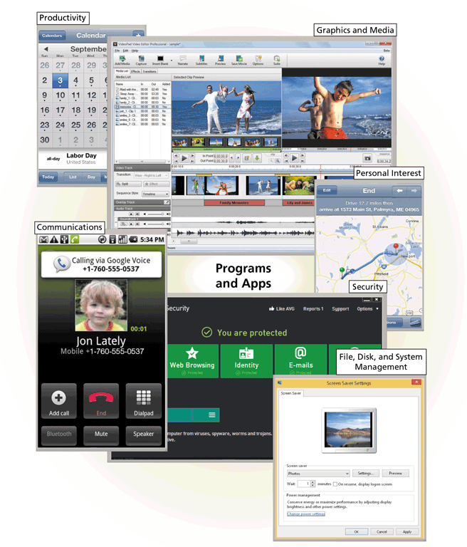
Programs and Apps
Page 159
Figure 4-1

Slide 6
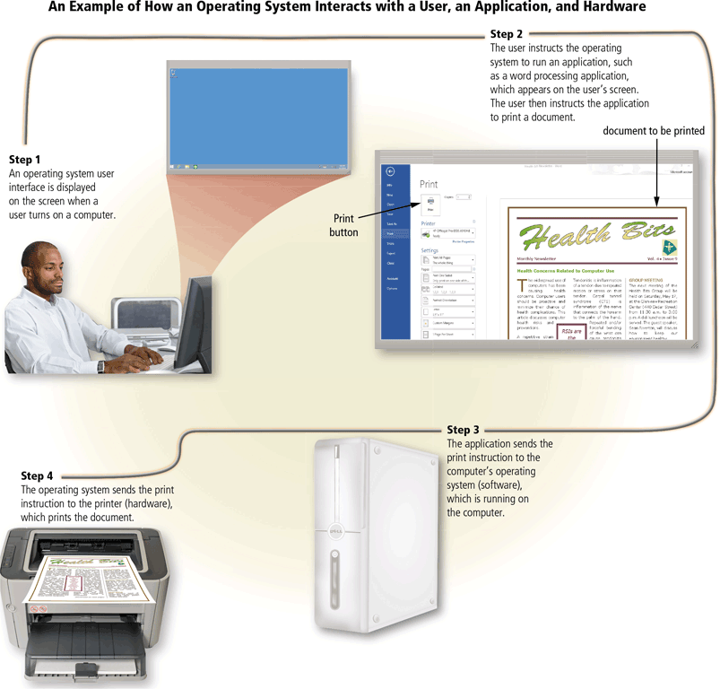
Programs and Apps
Page 160
Figure 4-2

Slide 7
Programs and Apps
Software is available in a variety of forms:
Retail
Shareware
Custom
Web app
Mobile app
Mobile web app
Freeware
Public domain
Open source
Page 161
Notes:
Retail software is used by all small, medium and large enterprises. The main purposes of using a software is to regulate pricing, calculate taxes, inventory management and manage POS, billing and payroll.
Examples:
Oracle NetSuite ERP
Horizon ERP. 5
Vyapar
MMI Xpert
------------------------------------------
→Custom software development is the process of designing, creating, deploying and maintaining software for a specific set of users, functions or organizations.
→build software that fits your business needs
For example, car manufacturers simply have nowhere to turn to purchase software for the vehicle on-board computer
------------------------
Web applications include online forms, shopping carts, word processors, spreadsheets, video and photo editing, file conversion, file scanning, and email programs such as Gmail, Yahoo and AOL. Popular applications include Google Apps and Microsoft 365.
---------------------------------------
For example online taxi apps. However, most popular types of applications here are scanners, trackers, healthcare, first aid manuals, etc. Examples of utility apps:
----------------------
Snapchat, Instagram, Google Maps and Facebook Messenger are some examples of popular mobile apps.
---------------
Shareware allows a user to try some or most of the features of a paid software for a limited period. The file can be shared to others as well but once the limited time period is over, the user has to pay to use the software further. Adobe Photoshop
---------------------
Freeware that is distributed at no financial cost to the end user. ...includes trial versions of software…….the source code for freeware is typically not made available.
-----------------------------------
Generically, open source refers to a program in which the source code is available to the general public for use and/or modification from its original design free of charge, i.e.,Open source code is typically created as a collaborative effort in which programmers improve upon the code and share the changes within the community.
Source code is basically a list of commands that dictate how the program executes.
→make source code available to others who would like to view that code, copy it, learn from it, alter it, or share it.
→Example: Android and linux kernel
----------------------------
Public domain software:
there is absolutely no ownership such as copyright, trademark, or patent….owned by public
public domain software does not carry copyright or patent
The software can be used, changed, and shared without further permissions.

Slide 8
Productivity Applications
Productivity applications can assist you in becoming more effective and efficient while performing daily activities at work, school, and home
Word processing
Presentation
Spreadsheet
Database
Note taking
Calendar and contact management
Project management
Accounting
Personal finance
Legal
Tax preparation
Document management
Enterprise computing
Page 165

Slide 9
Productivity Applications
With productivity applications, users often:
Create a project
Edit a project
Format a project
Save a project
Distribute a project
Pages 165 - 166

Slide 10
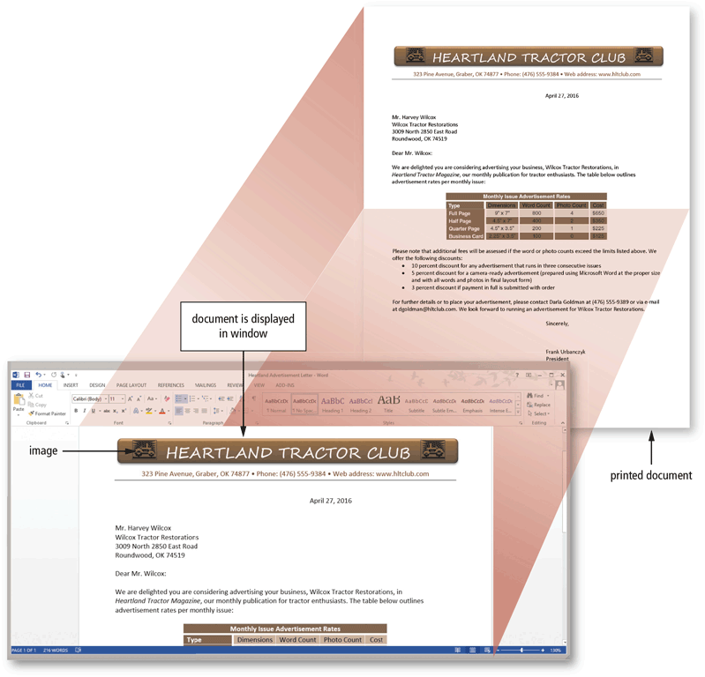
Productivity Applications
Word processing software allows users to create and manipulate documents
A major advantage of using word processing software is that it enables users to change their written words easily
Page 167
Figure 4-5

Slide 11

Productivity Applications
Presentation software allows users to create visual aids for presentations to communicate ideas, messages, and other information to a group
Page 168
Figure 4-6

Slide 12
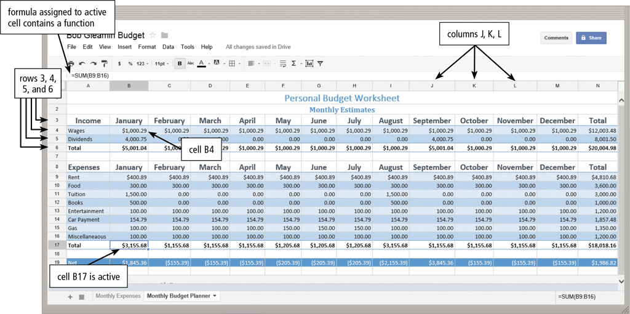
Productivity Applications
Spreadsheet software allows users to organize data in columns and rows and perform calculations on the data
Pages 168 - 169
Figure 4-7
Notes:
Spreadsheet software is a software application capable of organizing, storing and analyzing data in tabular form.
Spreadsheet software is defined as a type of computer program that helps a user perform numerical functions and analyze numbers through a computerized version of an accounting worksheet. An example of spreadsheet software is Excel.

Slide 13
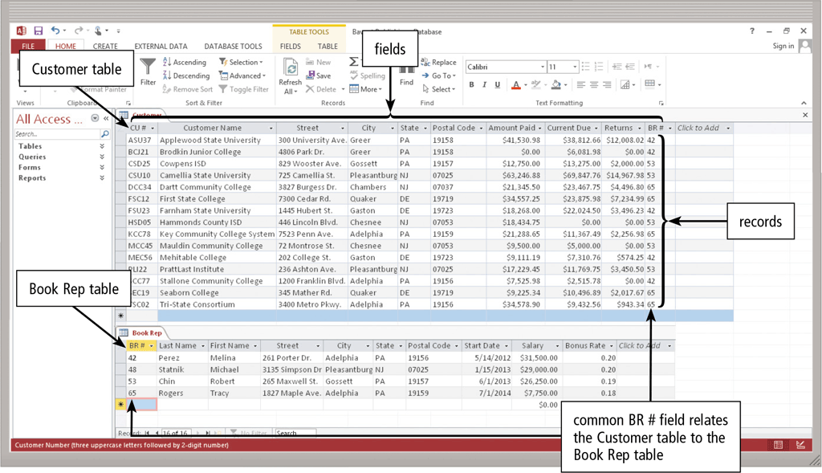
Productivity Applications
A database is a collection of data organized in a manner that allows access, retrieval, and use of that data
Database software allows users to create, access, and manage a database
Page 170
Figure 4-8
Notes:
A database is a collection of information that is organized so that it can be easily accessed, managed and updated. Computer databases typically contain aggregations of data records or files, containing information about sales transactions or interactions with specific customers.
One of the most common types of dynamic web pages is the database driven type. This means that you have a web page that grabs information from a database

Slide 14
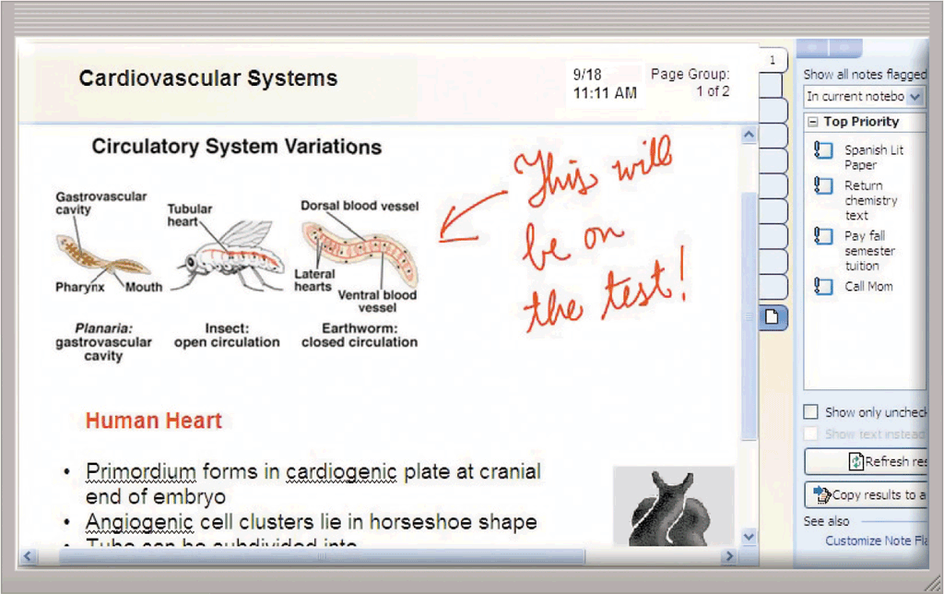
Productivity Applications
Note taking software is an application that enables users to enter typed text, handwritten comments, drawings, sketches, photos, and links anywhere on a page
Page 171
Figure 4-9
Notes:
Examples:
Microsoft OneNote.
Google Keep.
Evernote.

Slide 15
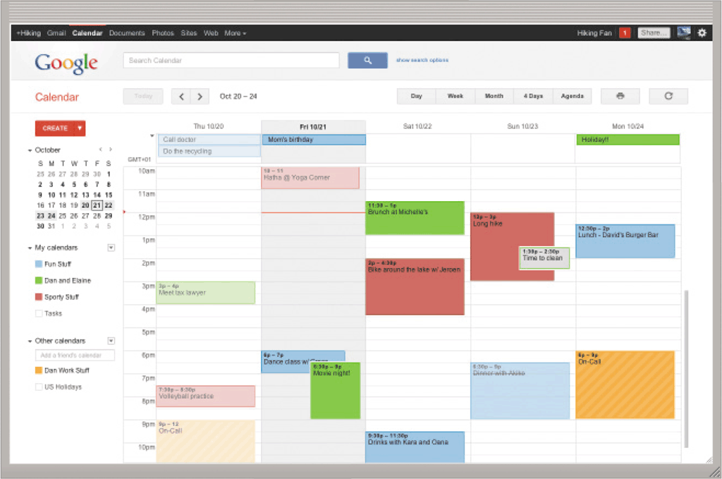
Productivity Applications
Calendar and contact management software is an application that helps you organize your calendar, keep track of contacts, and share this information with other users
Page 171
Figure 4-10
Notes:
A contact manager is a software program that enables users to easily store and find contact information, such as names, addresses and telephone numbers.
They are contact-centric databases that provide a fully integrated approach to tracking of all information and communication activities linked to contacts.
Examples
Bitrix24
infoflo

